Slide 1
Quick Guide: Update Your Support Group Flyer
Flyers are a simple way to let grandparents and other caregivers in your local Massachusetts community know about your support group. You can share them by email, post them online, or print them to put up at local libraries, schools, or community centers.
How to Update Your Flyer
There are 3 different template styles. Choose the one that you like best. Each flyer is designed so you can easily add details for your specific support group.
Go to section “What to Expect.” Review and change the wording so it fits your support group.
Update the date, time, and location so they are correct for your group.
Add your email address so people can contact you for more information or to get an invitation.
Look it over one more time. Then your flyer is ready to share.

Slide 2

WHAT TO EXPECT:
A welcoming, judgment‑free space
Connection with other grandparents & kin caregivers
Helpful information and shared resources
[ADD AN OPTION] food, guest speakers, ETC.
DATE:
Add the time
Add location
Any additional info (Zoom or childcare available)
Need more info?
Email xxx@youremail.com

Slide 3
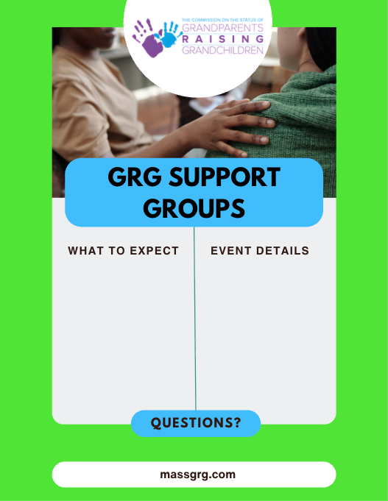
A welcoming, judgment‑free space
Connection with other grandparents & kin caregivers
Helpful information and shared resources
Optional activities, food, or guest speakers
DATE:
TIME:
LOCATION:
Additional details:
Email us at: xxx@xxx.com

Slide 4

Raising grandchildren or kin can feel isolating, overwhelming, and exhausting—get emotional support, trusted info, and help navigating systems like DCF, schools & courts.
A welcoming, judgment‑free space
Connection with other grandparents & kin caregivers
Helpful information and shared resources
Optional activities, food, or guest speakers
Date:
Time
Location
Additional details:
Email for more information: xxx@XXX.com
massgrg.com

